Slide 1

TONG HSING ELECTRONIC IND., LTD.
Second Quarter 2025
Earnings Result
Jul 29th, 2025
©2025 Tong Hsing
TONG HSING PROPERTY
P1

Slide 2
Disclaimer
This presentation contains forward-looking statements. These forward-looking statements are subject to risks, uncertainties and assumptions, some of which are beyond our control. Actual results may differ materially from those expressed or implied by these forward-looking statements. Because of these risks, uncertainties and assumptions, the forward-looking events and circumstances discussed in this presentation might not occur in the way we expect, or at all. You should not place undue reliance on any forward-looking information.
In preparing the information herein, Tong Hsing have relied upon and assumed, without independent verification, the accuracy and completeness of all information available from public sources or which was provided to Tong Hsing or which was otherwise reviewed by Tong Hsing. Neither Tong Hsing nor its advisors have made any representation or warranty as to the accuracy or completeness of such information and nor do they assume any undertaking to supplement such information as further information becomes available or in light of changing circumstances. None of Tong Hsing, nor any of their respective affiliates, advisers or representatives shall have any liability whatsoever(in negligence or otherwise) for any loss howsoever arising from any use of this presentation or its contents or otherwise arising in connection with this presentation. Neither this presentation nor any of its contents may be reproduced to a third party without the prior written consent of Tong Hsing.

Slide 3
Table of Contents
Financial Update
Business Update
Revenue by Applications
©2025 Tong Hsing
TONG HSING PROPERTY

Slide 4
2Q 25 Income Statement Q/Q Comparison
*2025 Q1 & Q2 Weighted Average Outstanding Shares : 209.058Million
©2025 Tong Hsing
TONG HSING PROPERTY
P4

Slide 5
2Q 25 Income Statement Y/Y Comparison
*2024 Q2 & 2025 Q2 Weighted Average Outstanding Shares : 209.058Million
©2025 Tong Hsing
TONG HSING PROPERTY
P5

Slide 6
2025Income Statement First Half Comparison
*2024 H1 & 2025 H1 Weighted Average Outstanding Shares : 209.058Million
©2025 Tong Hsing
TONG HSING PROPERTY
P6

Slide 7
Balance Sheet Highlight –6.30.2025
©2025 Tong Hsing
TONG HSING PROPERTY
P7

Slide 8
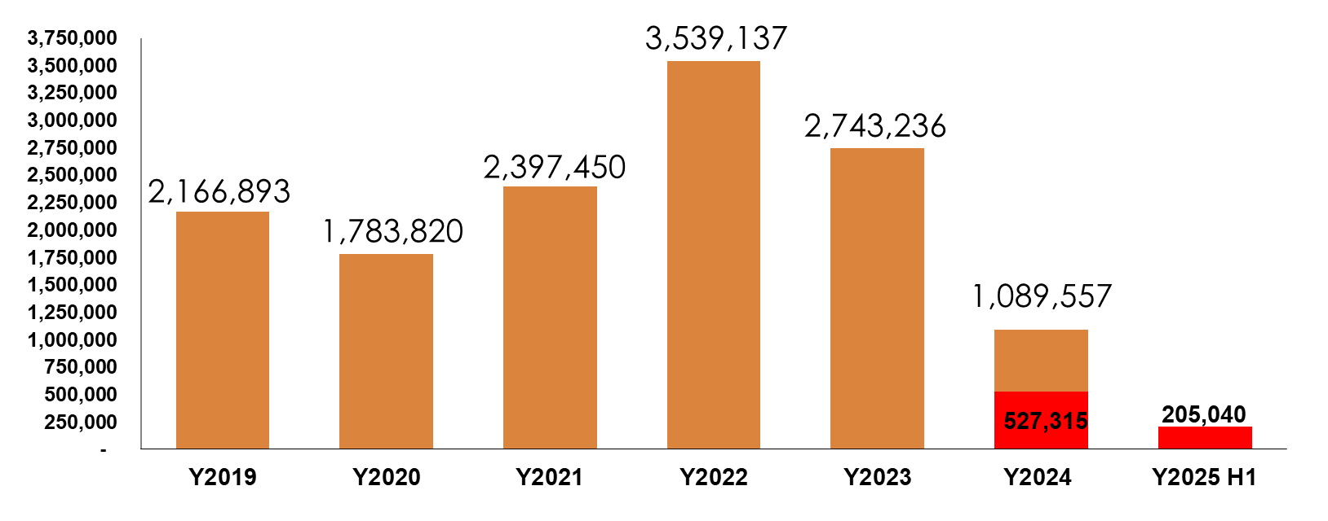
Capital Expenditure
$NTD/K
©2025 Tong Hsing

Slide 9
Table of Contents
Financial Update
Business Update
Revenue by Applications
©2025 Tong Hsing
TONG HSING PROPERTY

Slide 10
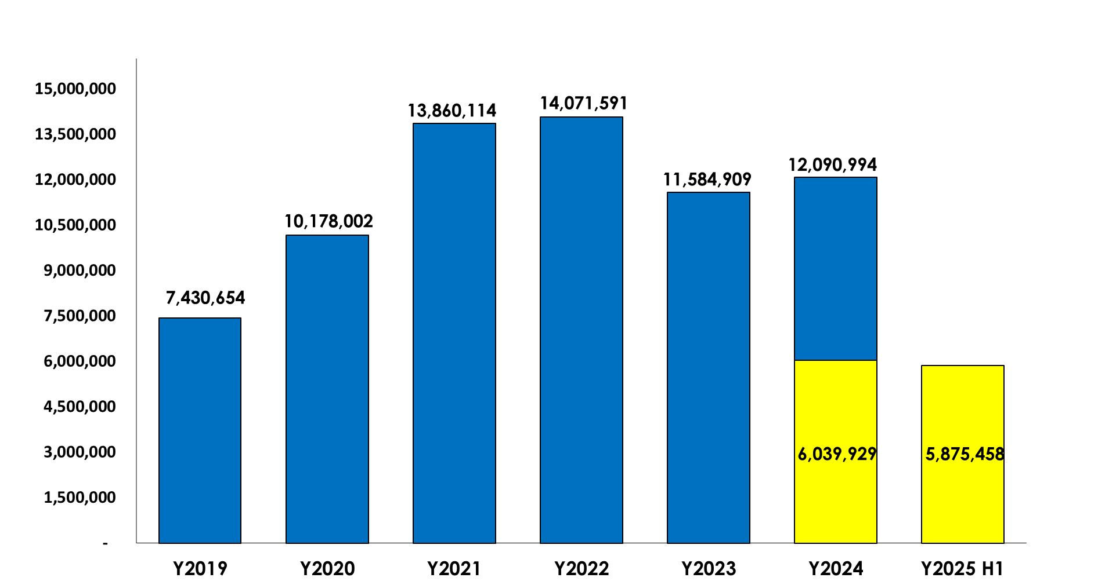
Tong Hsing Revenue History
$NTD/K
+2%
-18%
+4%
+36%
+37%
-3%
©2025 Tong Hsing
TONG HSING PROPERTY
P10

Slide 11
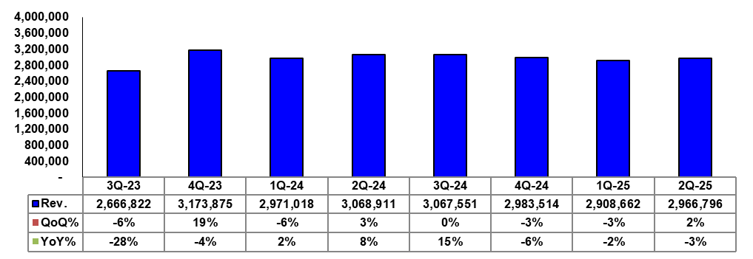
Tong Hsing Quarterly Revenue
$NTD/K
©2025 Tong Hsing
TONG HSING PROPERTY
P11

Slide 12
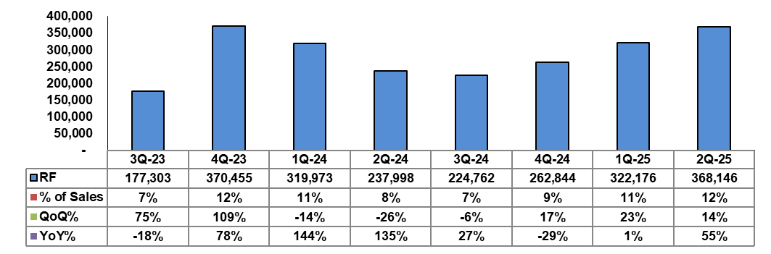
RF Module Quarterly Revenue Trend
$NTD/K
©2025 Tong Hsing
TONG HSING PROPERTY
P12

Slide 13
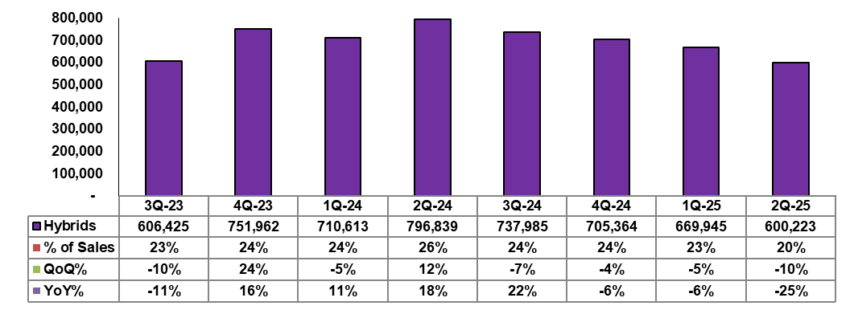
Hybrid Module Quarterly Revenue Trend
$NTD/K
©2025 Tong Hsing
TONG HSING PROPERTY
P13

Slide 14
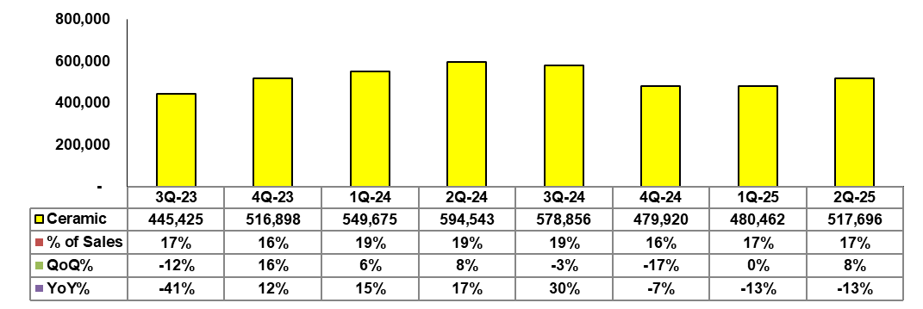
Ceramic Substrate Quarterly Revenue Trend
$NTD/K
©2025 Tong Hsing
TONG HSING PROPERTY
P14

Slide 15
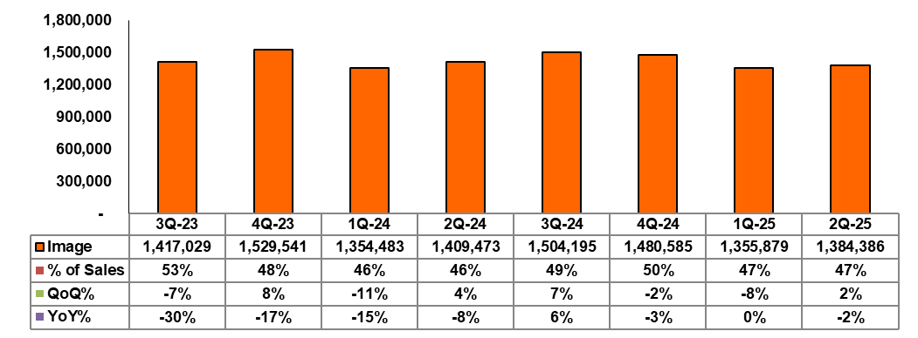
Image Product Quarterly Revenue Trend
$NTD/K
©2025 Tong Hsing
TONG HSING PROPERTY
P15

Slide 16
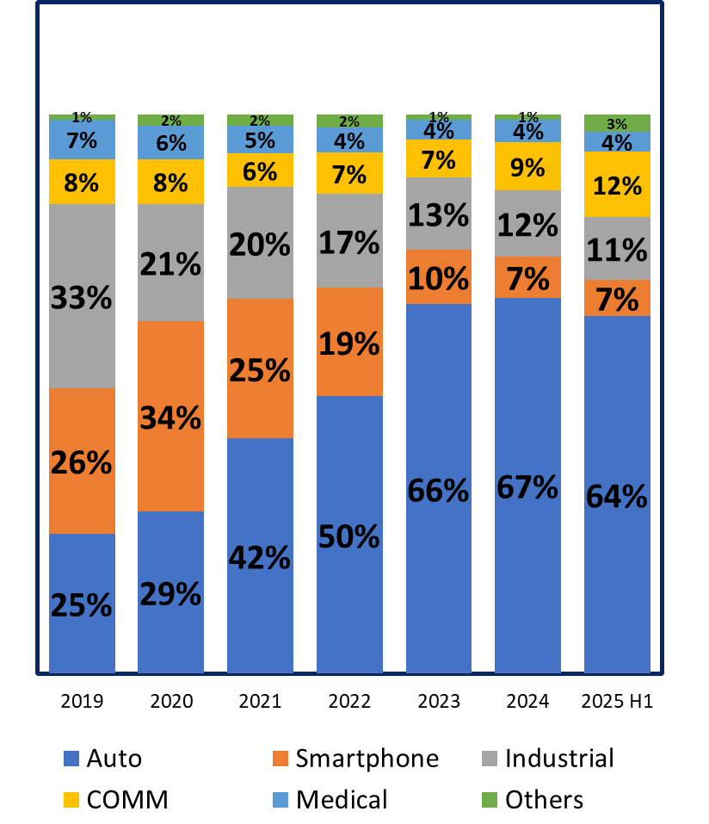
Revenue by Applications
Sales %
©2025 Tong Hsing
TONG HSING PROPERTY

Slide 17
Outlook
"Q3 revenue is expected to see a slight decline from Q2 levels, primarily driven by currency fluctuations.
©2025 Tong Hsing

Slide 18
Table of Contents
Financial Update
Business Update
Revenue by Applications
©2025 Tong Hsing
TONG HSING PROPERTY

Slide 19
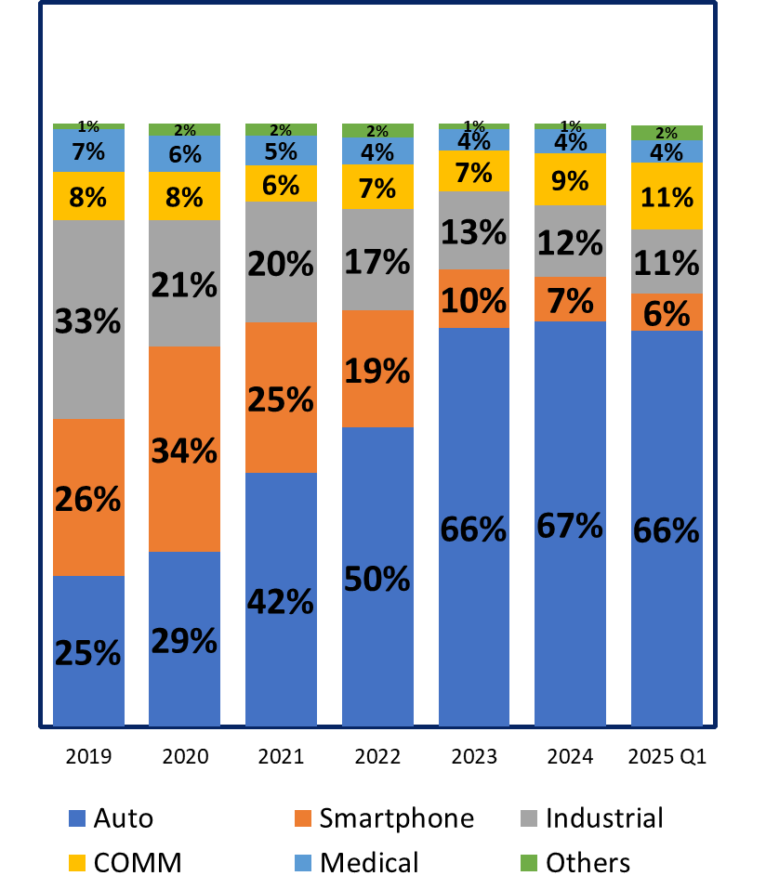
Revenue by Applications
Sales %
TONG HSING PROPERTY

Slide 20

Outlook
©2025 Tong Hsing

Slide 21









Thank you for Listening!
Reality / Integrity / Customer First
Please Visit Us @ https://www.theil.com
©2025 Tong Hsing
TONG HSING PROPERTY
P21

