Slide 1

TONG HSING ELECTRONIC IND., LTD.
Fourth Quarter 2024
Earnings Result
Feb 27th, 2025
©2025 Tong Hsing
TONG HSING PROPERTY
P1

Slide 2
Disclaimer
This presentation contains forward-looking statements. These forward-looking statements are subject to risks, uncertainties and assumptions, some of which are beyond our control. Actual results may differ materially from those expressed or implied by these forward-looking statements. Because of these risks, uncertainties and assumptions, the forward-looking events and circumstances discussed in this presentation might not occur in the way we expect, or at all. You should not place undue reliance on any forward-looking information.
In preparing the information herein, Tong Hsing have relied upon and assumed, without independent verification, the accuracy and completeness of all information available from public sources or which was provided to Tong Hsing or which was otherwise reviewed by Tong Hsing. Neither Tong Hsing nor its advisors have made any representation or warranty as to the accuracy or completeness of such information and nor do they assume any undertaking to supplement such information as further information becomes available or in light of changing circumstances. None of Tong Hsing, nor any of their respective affiliates, advisers or representatives shall have any liability whatsoever(in negligence or otherwise) for any loss howsoever arising from any use of this presentation or its contents or otherwise arising in connection with this presentation. Neither this presentation nor any of its contents may be reproduced to a third party without the prior written consent of Tong Hsing.

Slide 3
Table of Contents
Financial Update
Business Update
Revenue by Applications
©2025 Tong Hsing
TONG HSING PROPERTY

Slide 4
4Q 24 Income Statement Q/Q Comparison
*2024 Q4 Weighted Average Outstanding Shares : 209.058Million
*2024 Q3 Weighted Average Outstanding Shares : 209.058Million
©2025 Tong Hsing
TONG HSING PROPERTY
P4

Slide 5
4Q 24 Income Statement Y/Y Comparison
*2024 Q4 Weighted Average Outstanding Shares : 209.058Million
*2023 Q4 Weighted Average Outstanding Shares : 209.058Million
©2025 Tong Hsing
TONG HSING PROPERTY
P5

Slide 6
2024 Income Statement Comparison
*2024 Weighted Average Outstanding Shares : 209.058Million
*2023 Weighted Average Outstanding Shares : 209.058Million
©2025 Tong Hsing
TONG HSING PROPERTY
P6

Slide 7
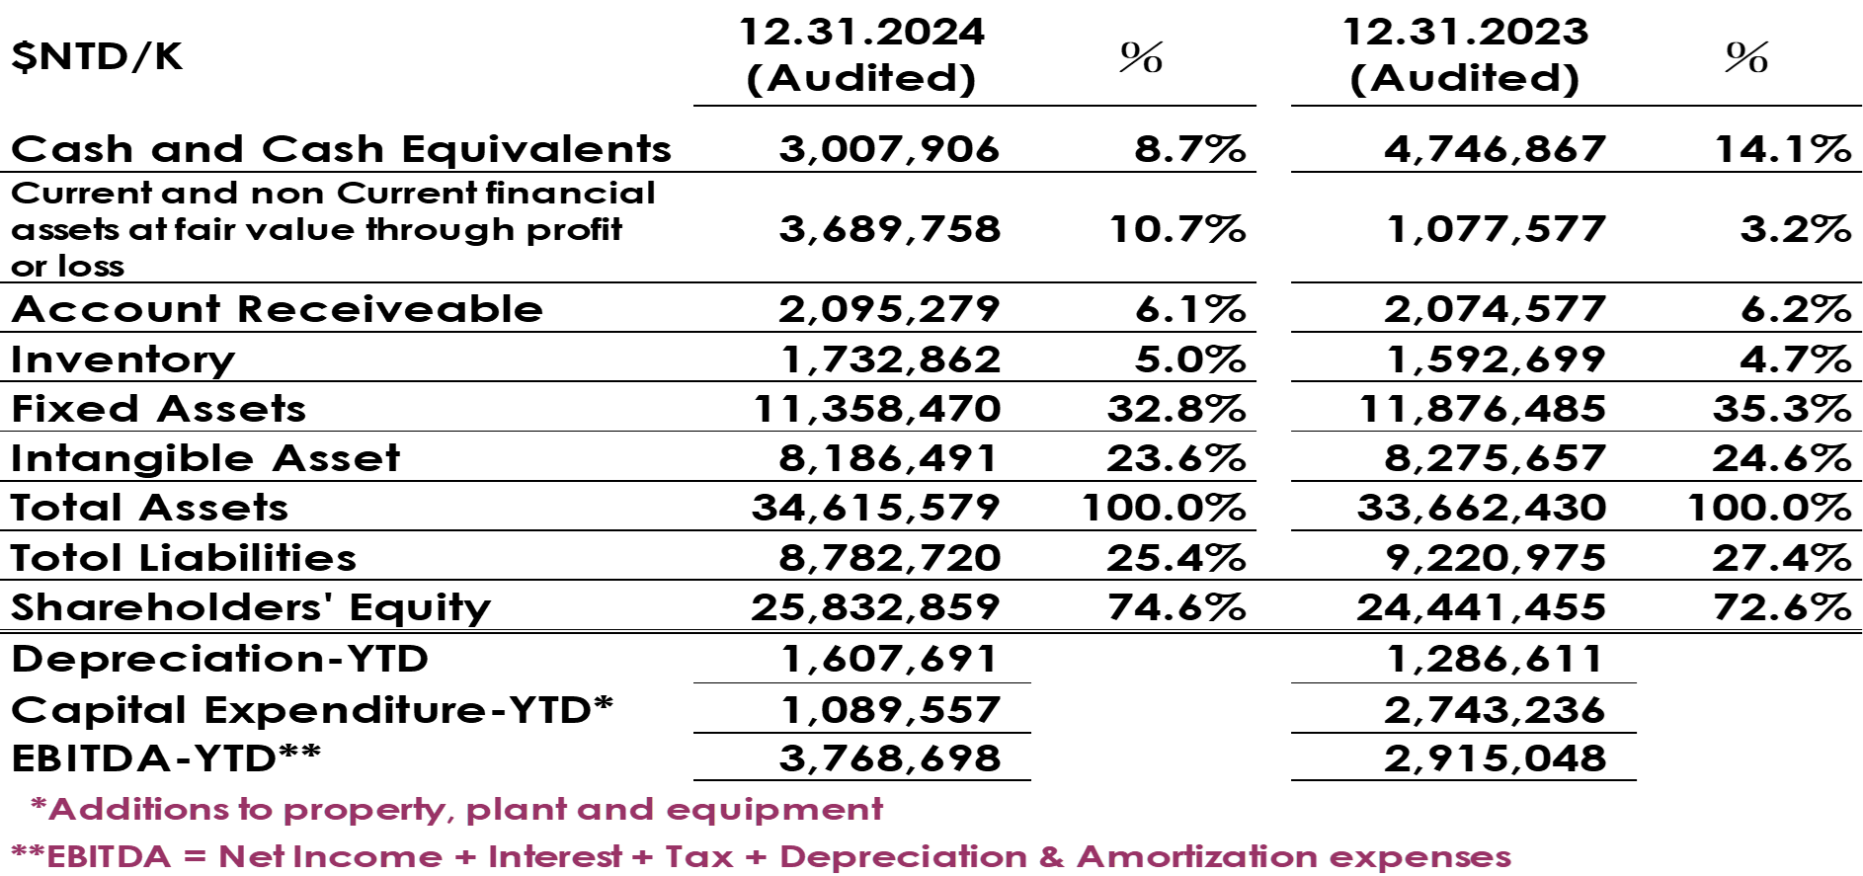
Balance Sheet Highlight –12.31.2024
©2025 Tong Hsing
TONG HSING PROPERTY
P7

Slide 8
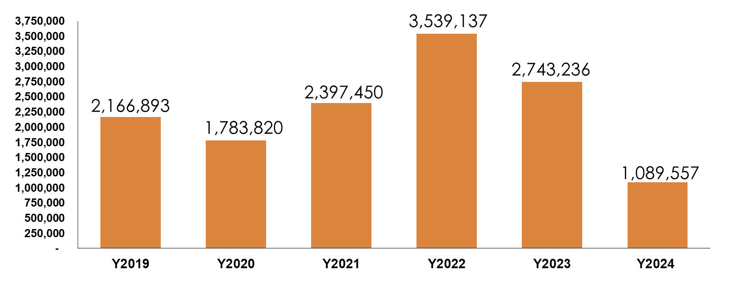
Capital Expenditure
$NTD/K
©2025 Tong Hsing

Slide 9
Table of Contents
Financial Update
Business Update
Revenue by Applications
©2025 Tong Hsing
TONG HSING PROPERTY

Slide 10

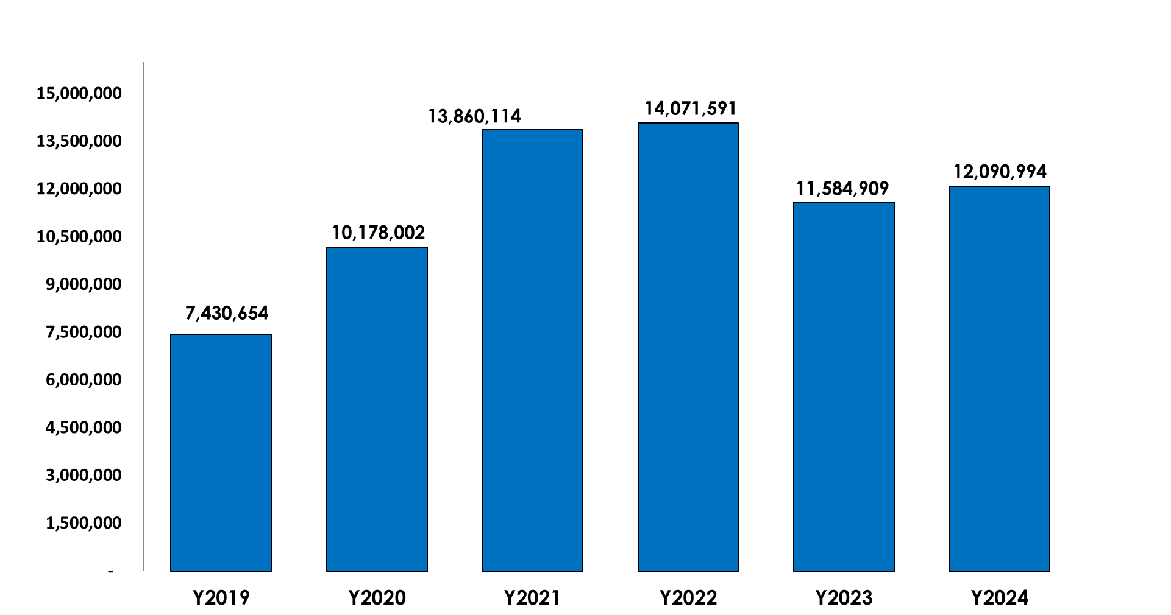
Tong Hsing Revenue History
$NTD/K
+2%
-18%
+4%
+36%
+37%
©2025 Tong Hsing
TONG HSING PROPERTY
P10

Slide 11
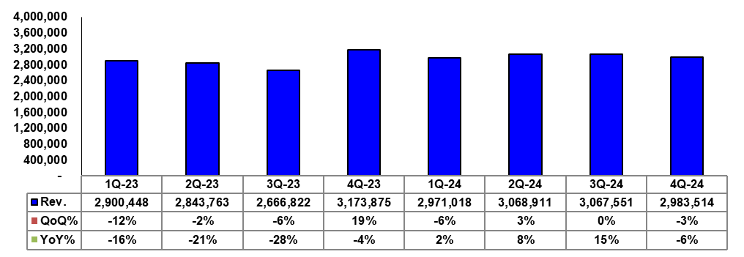
Tong Hsing Quarterly Revenue
$NTD/K
©2025 Tong Hsing
TONG HSING PROPERTY
P11

Slide 12
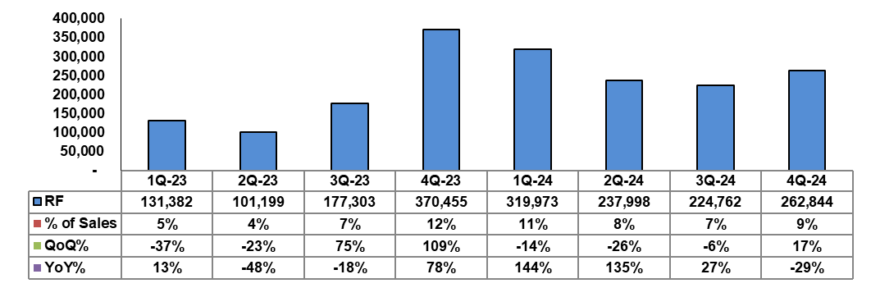
RF Module Quarterly Revenue Trend
$NTD/K
©2025 Tong Hsing
TONG HSING PROPERTY
P12

Slide 13
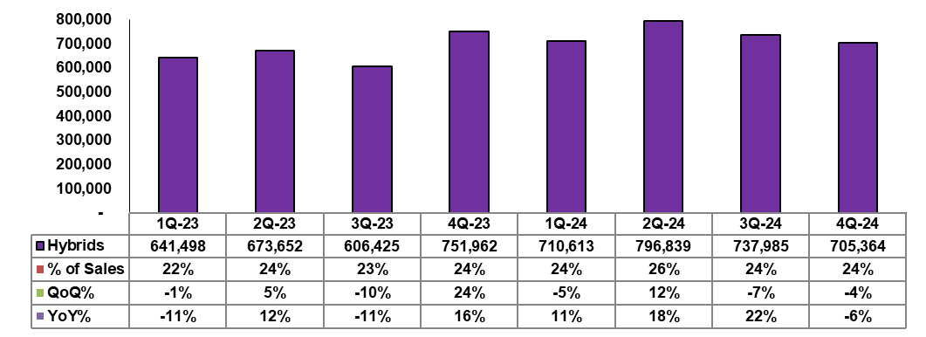
Hybrid Module Quarterly Revenue Trend
$NTD/K
©2025 Tong Hsing
TONG HSING PROPERTY
P13

Slide 14
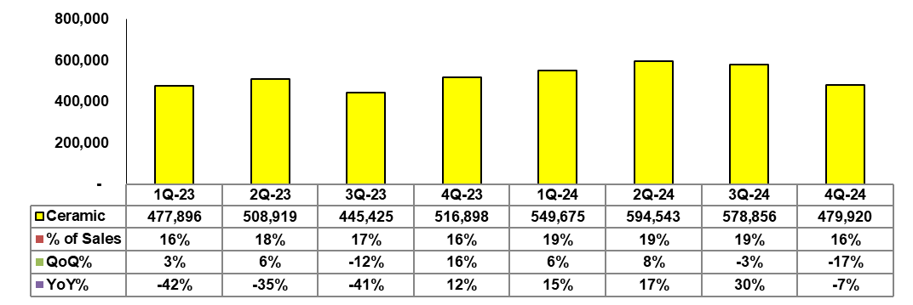
Ceramic Substrate Quarterly Revenue Trend
$NTD/K
©2025 Tong Hsing
TONG HSING PROPERTY
P14

Slide 15
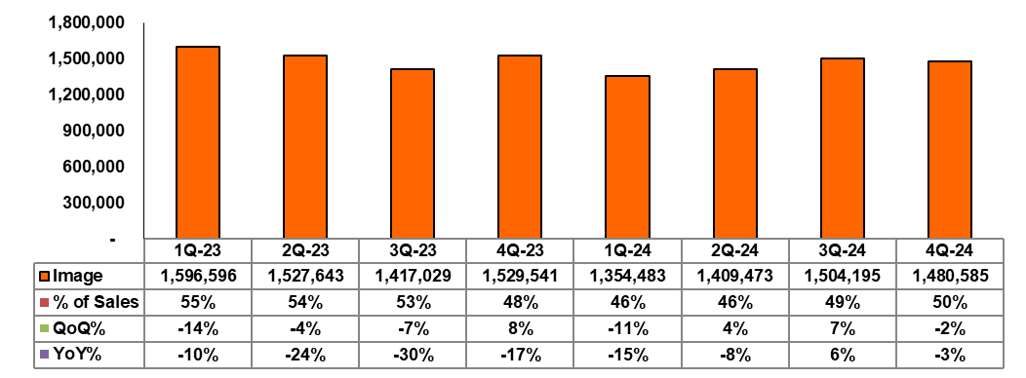
Image Product Quarterly Revenue Trend
$NTD/K
©2025 Tong Hsing
TONG HSING PROPERTY
P15

Slide 16
Table of Contents
Financial Update
Business Update
Revenue by Applications
©2025 Tong Hsing
TONG HSING PROPERTY

Slide 17
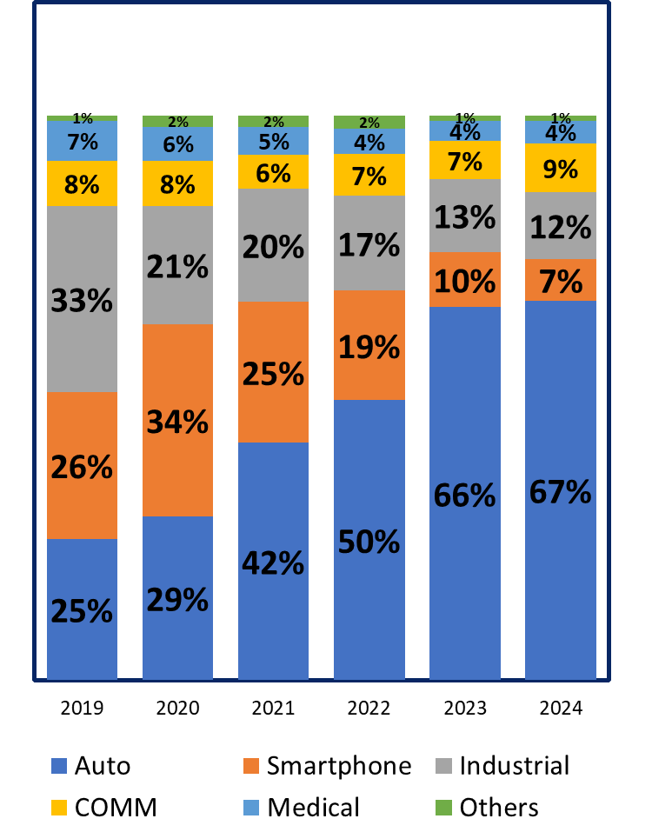
Revenue by Applications
Sales %
©2025 Tong Hsing
TONG HSING PROPERTY

Slide 18
Outlook
“Due to seasonality, we expect our revenue for Q1 2025 to decline by mid single-digit percentage, compared to Q4 2024.”
©2025 Tong Hsing

Slide 19









Thank you for Listening!
Reality / Integrity / Customer First
Please Visit Us @ https://www.theil.com
©2025 Tong Hsing
TONG HSING PROPERTY
P19

